Slide 1


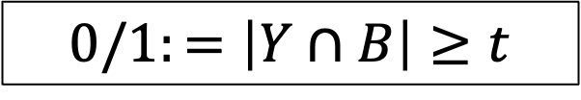
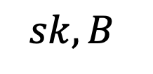
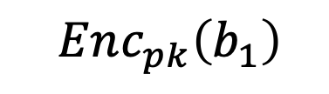
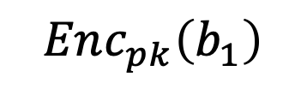


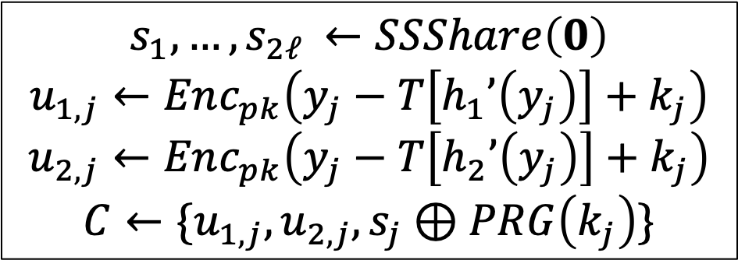
…
$$h_{1}’\left(b_{i}\right)$$
$$Enc_{pk}\left(b_{1}\right)$$
…
$$b_{i}$$
…
$$h_{2}’\left(b_{i}\right)$$
$$Enc_{pk}\left(b_{1}\right)$$
$$sk, B$$
$$C$$
Search
$$s_{1},…,s_{2ℓ }←SSShare\left(0\right)$$
$$u_{1,j}←Enc_{pk}\left(y_{j}−T\left[h_{1}’\left(y_{j}\right)\right]+k_{j}\right)$$
$$u_{2,j}←Enc_{pk}\left(y_{j}−T\left[h_{2}’\left(y_{j}\right)\right]+k_{j}\right)$$
$$C←\{u_{1,j},u_{2,j},s_{j}⊕PRG\left(k_{j}\right)\}$$
$$0/1:=\left|Y∩B\right|≥t$$

